Slide 1
Read Concern
Read concern vs Read preference
Read preference: decide which replication to read
Read concern: decide which level data to be read
level | Description
Local [default] | query returns data from the instance with no guarantee
Available | For sharded clusters: provides greater tolerance for partitions since it does not wait to ensure consistency guarantees
majority | The query returns the data that has been acknowledged by a majority of the replica set members
linearizable | The query returns data that reflects all successful majority-acknowledged writes that completed prior to the start of the read operation.是majority的improve版本，主要是當在read之前會先確認當前的primarity是否能看到多數的secondar 確定後才開始讀，但會有pently，因此並非majority的替代 Only read from primary
snapshot | Majority for multi-document transaction
Notes:
readPreference 決定從哪個節點讀取，readConcern 決定該節點的哪些數據是可讀的

Slide 2
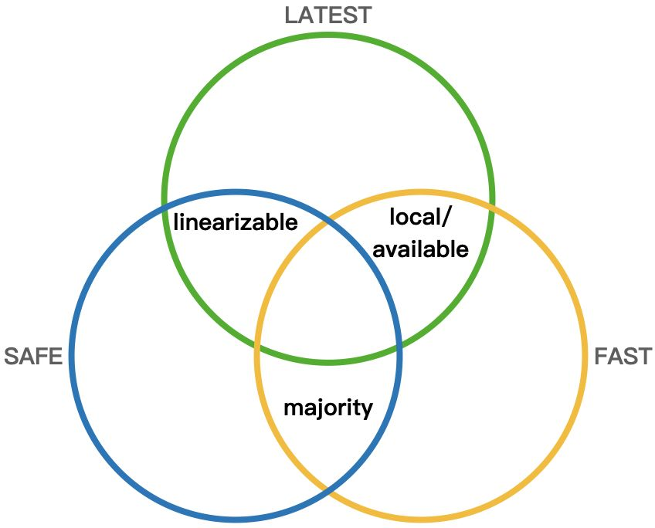
Notes:
https://zhuanlan.zhihu.com/p/356980354

Slide 3
Write Concern

